Slide 1
Funding Blocks Trust
Decentralised fundraising for Transparent Actions

Slide 2
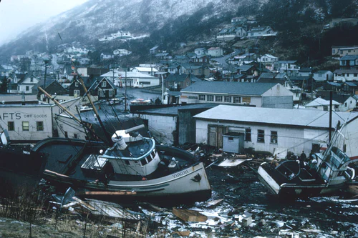
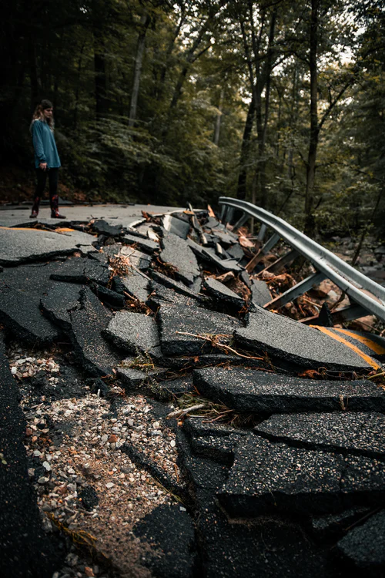
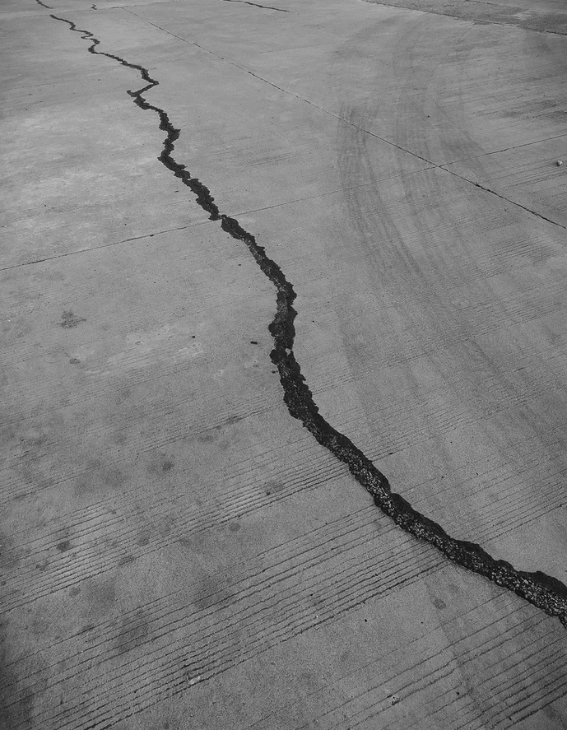
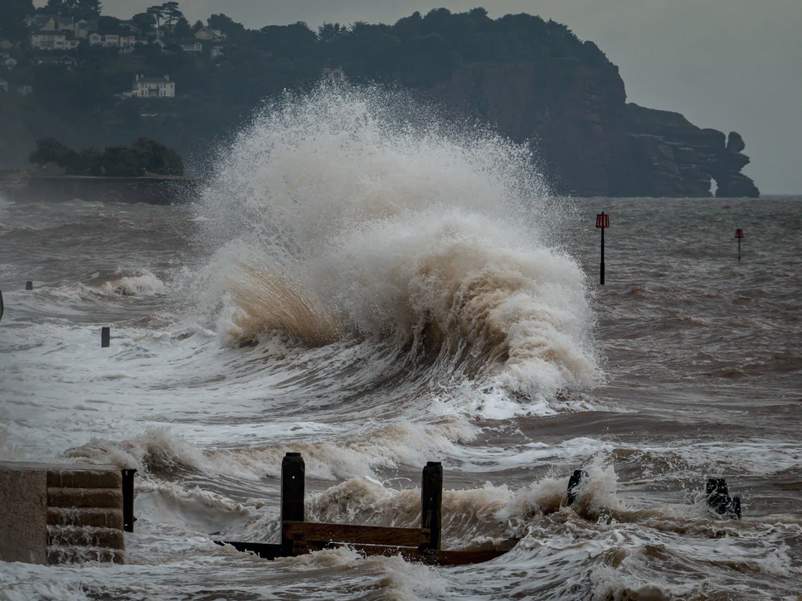
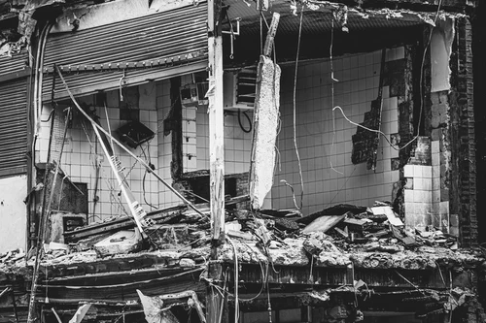
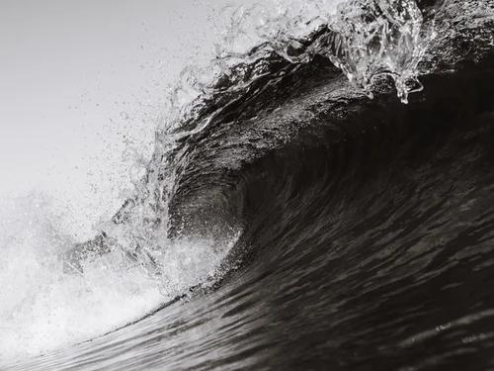
Japan Earthquake
and Tsunami

Slide 3

Some of the Fundraising Organizations
Kumamoto Japan Relief Fund Raised: $850,635
Time Taken: 5 years
Japan Earthquake and Tsunami relief fund
Raised: $9.08M
Time Taken: 10 years
Source: GlobalGiving.org

Slide 4
Is it the amount that is lagging or
Time?

Slide 5
Where’s the Problem?
People donate less
No trust on the organisations
They don’t get anything in return
Sometimes It takes weeks to raise the minimum amount needed
Average person gets aware in around 24 hours
Spreading awareness consumes majority of time
Some people are ready to contribute but don’t have funds on time.
What if they raised 100k but only used 80k?
No one knows
But the donors have a right to know

Slide 6
Need of the FUTURE.
Learn from the past.

Slide 7
Presenting Funding Blocks Trust
World’s first Decentralised Disaster Relief Funds
Transparent
Fast & Simple
Decentralised fundraising So our project creates an “Trustless Pre-Funding can Finally Save Lives”

Slide 8
Features
Donors can raise fund before a calamity has occurred
Funds cannot be stolen
They cannot be withdrawn without any need
Total amount collected is always transparent
They get Certificate for donation as NFT
The total time can be just a couple of minutes
Donors vote for the amount to be withdrawn
Amount withdrawn is fully transparent

Slide 9
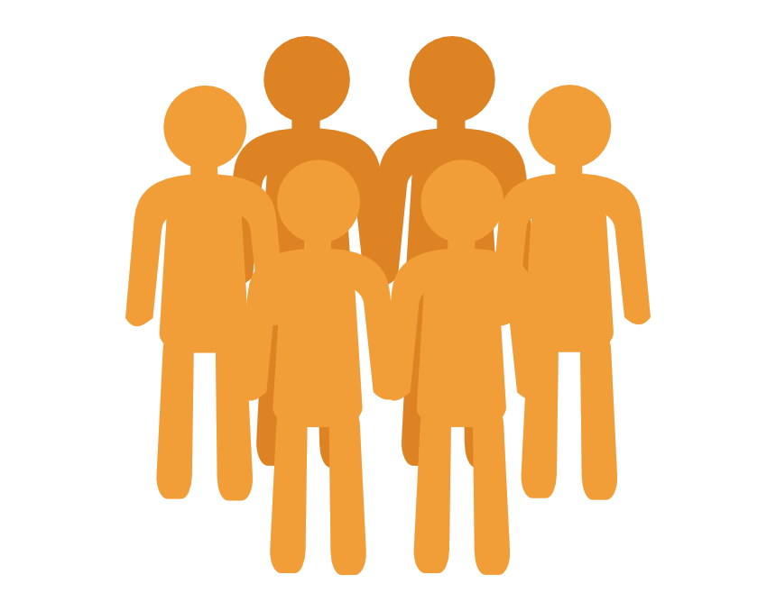
How it works?
1.
Donors collectively raise the funds in the main “Funding Block”
2.
The needy people creates a Funding Block for some disaster relief
3.
Donors individually vote to
Disaster
decide the amount to be
4. Decided Funds are transferred
withdrawn for this disaster
Donors
Blockchain

Slide 10
Automated Funds Transfer
Donors vote for the amount to be withdrawn
The voting process continues until
25% of the total donors have voted or
50% have report it
If ≥ 50% donors have reported, the Funding Block is canceled
Else, the funds are transferred to the organisation.

Slide 11

Key Differentiators
Trustless
Speed
Transparent
Decentralised
Reward
Donors decide the amount
Voting takes just a few hours
All numbers are public
Power is distributed
Donors get Certificate NFT

Slide 12
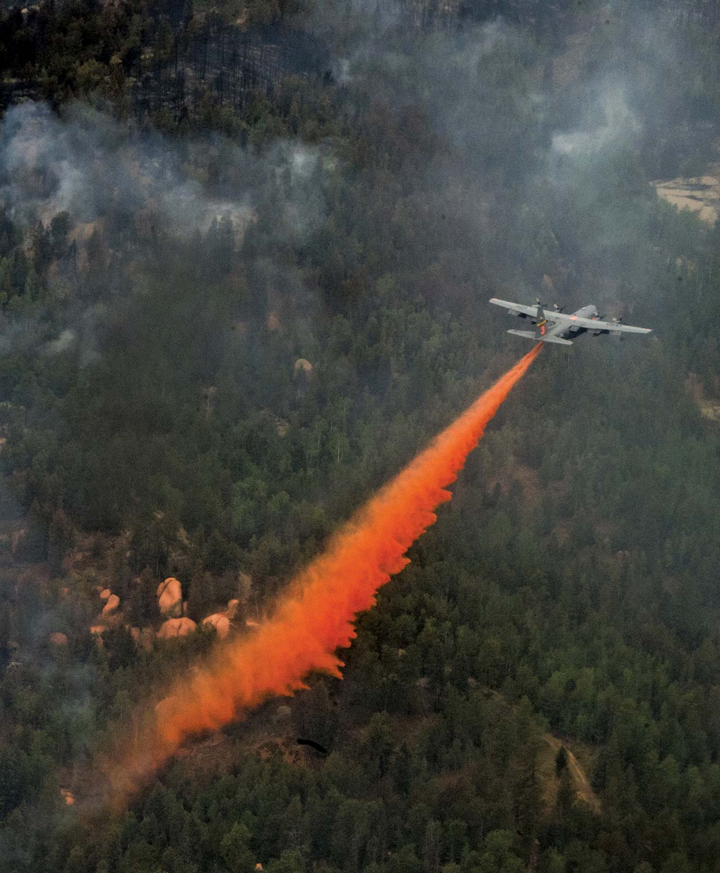
Use-Cases
Natural Disasters
Wildfires
Tsunamis
Earthquakes
Cyclones
Floods
Tornados
Terror Attacks
The next Pandemic

Slide 13
Future Enhancements
Personal
Fundraising
Startup
Funding
Refugee
Relief
Anyone will be able to raise funds
Startups can also create their Funding Blocks
The total relief funds will be distributed to each wallet separately

Slide 14
Thank You

